Slide 1
Drought Predictions Using Weather and Soil Data
Tania Ommer

Slide 2
THE DATA
Description:
This dataset predicts possible droughts in the US using previous drought monitoring data and measurements. It aims to predict droughts using only US meteorological data, in attempt to generalize predictions to other areas of the world. It utilizes six different levels of drought to classify each entry, along with meteorological indicators to accompany each point.
Attributes:
US county FIPS code
Latitude
Longitude
Median Elevation (meters)
Slope of land
Land Type (water bodies, grass/woodland, forest land)
Land Conditions (nutrient availability, rooting conditions, toxicity)

Slide 3
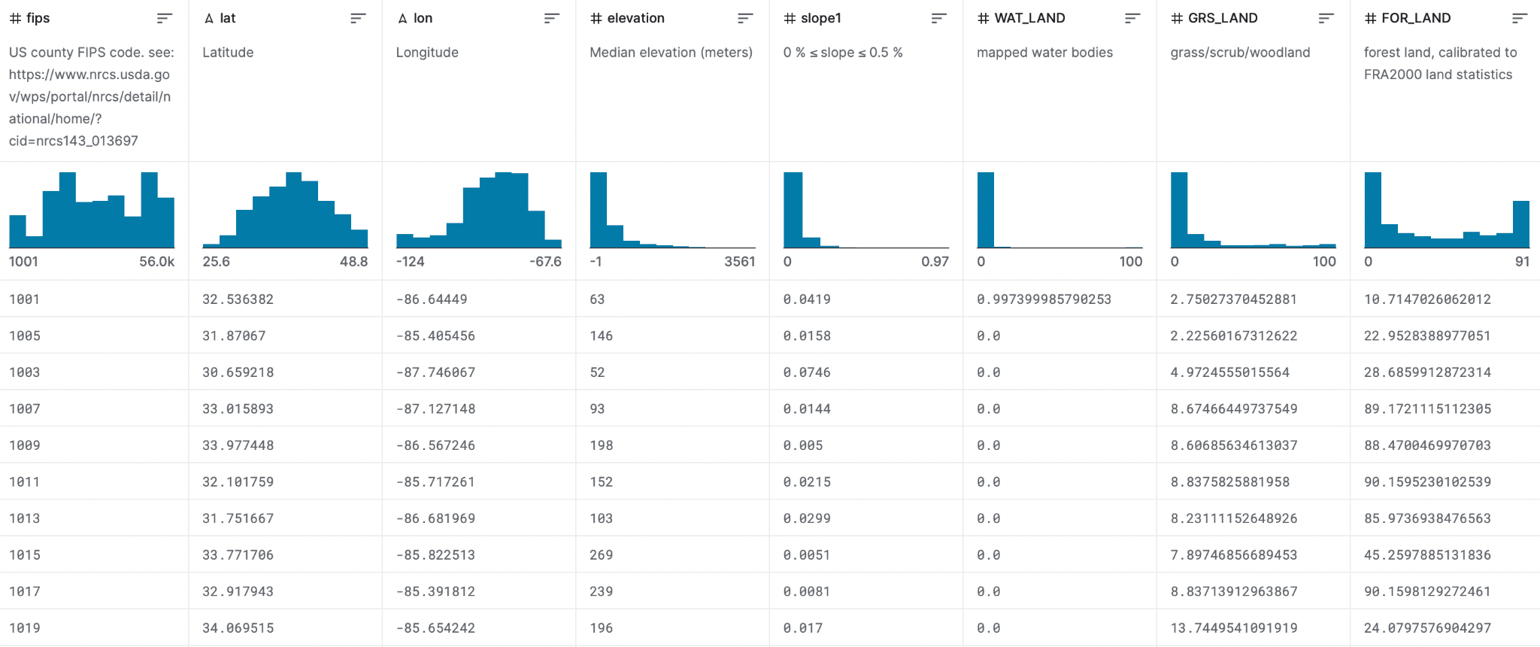
THE DATA (CONT.)
https://www.kaggle.com/datasets/cdminix/us-drought-meteorological-data?select=soil_data.csv

Slide 4
THE DATA (CONT.)
For each US county, the dataset shows various indicators and attributes of the land that help to predict future drought conditions. Information such as the land type, elevation and slope levels, cultivated land levels, root conditions, and workability are provided for each listed county.
Full list of factors for each county:
for each Latitude, longitude, median elevation in meters, 8 slope levels, directional slope aspects (N, S E, W), land conditions(mapped water bodies, sparsely vegetated, urban, grass/woodland), cultivation land levels, nutrient availability, rooting conditions, oxygen available to roots, excess salts, toxicity, workability

Slide 5
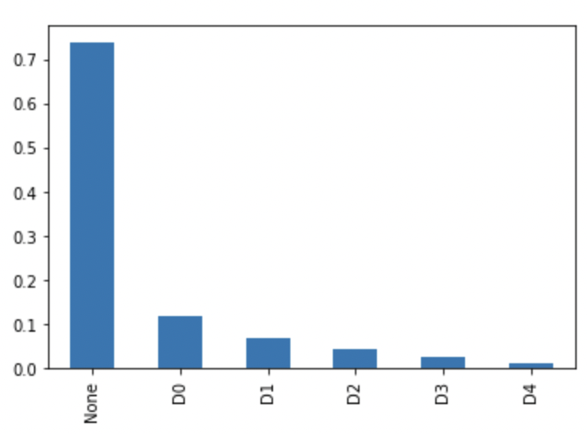
HOW CAN WE USE THIS DATA?
We can use this dataset to study the different meteorological factors of each US county and how that has impacted drought conditions in the area.
Through this information, we can make potential predictions of drought conditions in these counties for the future.
This information can teach researchers more about what land conditions contribute to different drought levels, like the six classifications used in the dataset.
No drought, D0 - abnormally dry, D1- moderate doubt, D2 - severe drought, D3 - extreme drought, D4 - exceptional drought
Further study could allow for researchers to apply these predictions to regions outside of the US, with the hope of generalizing drought conditions and data.
Shows frequency of counties for each drought level from the dataset

Slide 6
WHY IS THIS DATA INTERESTING?
The drought conditions and the meteorological indicators present in this dataset are interesting because they can contribute to larger issues such as global warming and climate change discussions.
Attributes like land type and cultivation levels illustrate the differences in each US county’s geography and how such conditions ultimately lead to low surface water levels and dry conditions.
How do certain drought conditions contribute to rising temperatures and global warming?
Increased temperatures enhance evaporation and dry out soil due to the loss of surface water. This results in lower precipitation levels and drought conditions.
Additionally, this data is interesting because it has a social impact on society. Droughts can have serious impacts on citizens and their safety.
What are the social impacts of droughts?
Droughts can cause loss of income, employment, agricultural production, and potentially poverty. Understanding this data and establishing potential drought predictions can benefit civilians and maintain public safety in the future.

